Slide 1


Public Workshop: Trip & Equipment Grant Allocation Methodology
June 26, 2020

Slide 2

Objectives of the Public Workshop
Gain an understanding of the current allocation methodology of the Trip & Equipment Grant;
Explore datasets that could be applied to (or enhanced in) the funding formula; and
Gather input on potential changes to the methodology adopted in Rule 41-2.014, FAC

Slide 3

Meeting Rules
This is a public meeting under Florida’s Government in the Sunshine Act.
This meeting is being recorded.
All audio and phone lines are muted.
Speakers that submitted a public comment form will be selected first.
Webinar speakers will be unmuted when called on by the meeting facilitator.
Phone participants will be instructed on unmuting their phone lines.
All speakers during public input will be limited to 5 minutes.

Slide 4

Webinar Tutorial

Slide 5

Funding Allocation Study
Scope & Objectives

Slide 6

Trip & Equipment Grant
Majority of Transportation Disadvantaged Trust Fund (TDTF) dollars are funded by the T&E Grant, subject to legislative appropriation.
Grant funds are allocated to each county’s Community Transportation Coordinator (CTC).
Allocation methodology established in Rule 41-2.014, FAC, in 1990s.
CTD implemented changes through legislative proviso for two fiscal years (2017-18, 2018-19).
CTD announced notice for development of rulemaking in 2019 to explore changes to the allocation methodology.
Insightful consideration of potential changes is essential before moving forward…

Slide 7

“Decisions will be better, and better understood and supported, if transparency, discussion and debate, communication and collaboration precede them.”
Robert Gates
Former U.S. Secretary of Defense

Slide 8
Study Objectives
Conduct an in-depth analysis of data used within the current allocation methodology
01
Facilitate stakeholder workshops to gather input on funding models for future consideration
02
Develop a final report that recommends changes to the funding methodology to be implemented in rule by July 1, 2021.
03

Slide 9
Guiding Principles
Access
Ensure Floridians who are transportation disadvantaged have access to community
Innovation
Allow local systems to test and apply new ideas to services.
Coordination
Promote cost-effective delivery of TD services.
Accountability
Ensure state taxpayer funding is being spent for its intended purpose.
Transparency
Make information available and understandable to stakeholders.

Slide 10

Questions to Consider for this Presentation…
Should the funding model weigh TD groups (i.e., older adults, individuals with disabilities, and persons with low-income) equally or differently?
What about individuals who fall in more than one group (e.g., living with a disability and below poverty)?
Should the funding model weigh population size areas (i.e., rural, small urban, large urbanized, etc.) equally or differently?
If miles of public roads are considered, should the funding model also consider functional classifications (e.g., Interstates, local roads, etc.) and/or number of lanes?
In the models presented, different weights are assigned to different trip types (ambulatory, wheelchair, etc.). Are these weights appropriate?
What is the appropriate weight for vehicle miles? The models presented weigh miles one-tenth the level that trips are.

Slide 11
…Questions to Consider for this Presentation
In the models presented, the Base Funding is an added variable to the Formula and based on a percent of a county’s previous year allocation:
Is weighting this variable at 50% appropriate?
Is measuring this variable according to a county’s statewide share of total allocations from the previous year appropriate?
Is Base Funding more important to smaller counties or larger counties?
The models presented consider the 5-year estimates on population, rather than 1-year data, to show a smooth trend:
Should the other variables presented in these models attempt to use a similar approach, such as rolling a multi-year average?

Slide 12

Understanding the Current Methodology
Analysis of the Variables and Datasets

Slide 13


Allocations VS Disbursements

Slide 14
Allocation/Disbursement Process
Transportation Disadvnataged Trust Fund (TDTF)
Trip & Equipment Grant Allocation to CTC
Trip & Equipment Grant Appropriation
CTC Disbursements for trips sponsored by DOE
CTC Disbursements for trips sponsored by DOEA, etc.
CTC Disbursements for trips sponsored by APD
CTC Disbursements for trips sponsored by AHCA
CTC Disbursements for non-sponsored trips provided by CTD

Slide 15

Rule 41-2.014(5), FAC
A county’s total allocation is determined by two components:
Base Funding – Based on the county’s equivalent T&E allocation from Fiscal Year 1999-00
Formula Funding – Based on the county’s service demand and performance
The Base provides an upfront allocation “in order to maintain system and service stability”
Remaining funds are allocated by the Formula based on four variables, weighted at 25%:
“Total county area in square miles”
“Total system passenger trips” reported in the county’s Annual Operating Report (AOR)
“Total system vehicle miles traveled” reported in the county’s AOR
“Total county population”

Slide 16
Applying the Current Methodology: Alachua County
The allocations represent amounts that were appropriated in FY2019-20, prior to “hold harmless” funding that was applied in November 2019.

Slide 17
Calculating Current Formula Funding: Alachua County
Statewide Formula Funding: $30,047,495.93*
Share of Square Miles: [($7,511,873.98*902/54,157)
Share of Total Population: +($7,511,873.98*259,865/20,278,447)
Share of AOR Trips: +($7,511,873.98*88,740/22,514,853)
Share of AOR Miles: +($7,511,873.98*1,129,073/99,057,595)]
Alachua Total: =$336,604.54
$7.5 million represents 25% of the $30 million in total statewide Formula funding for FY2019-20.

Slide 18
Effective Current Total Distributions: Alachua County

Slide 19
Valuing Each Formula Category: County and Statewide
Per Input (Value) Allocation: Alachua
Value Per Square Mile: $125,112.36/902=$138.71
Value Per Person: $96,263.44/259,865=$0.37
Value Per AOR Trip: $29,607.29/88,740=$0.33
Value Per AOR Mile: $85,621.44/1,129,073=$0.08
Statewide
$7,511,873.98/54,157=$138.71
$7,511,873.98/20,278,447=$0.37
$7,511,873.98/22,514,853=$0.33
$7,511,873.98/99,057,595=$0.08
The Formula values $0.33 per trip reported in the AOR, $0.37 per resident in a county, etc. The value of each category can be altered when exploring alternative ways of determining a county’s allocation.

Slide 20

Diving into the Data

Slide 21

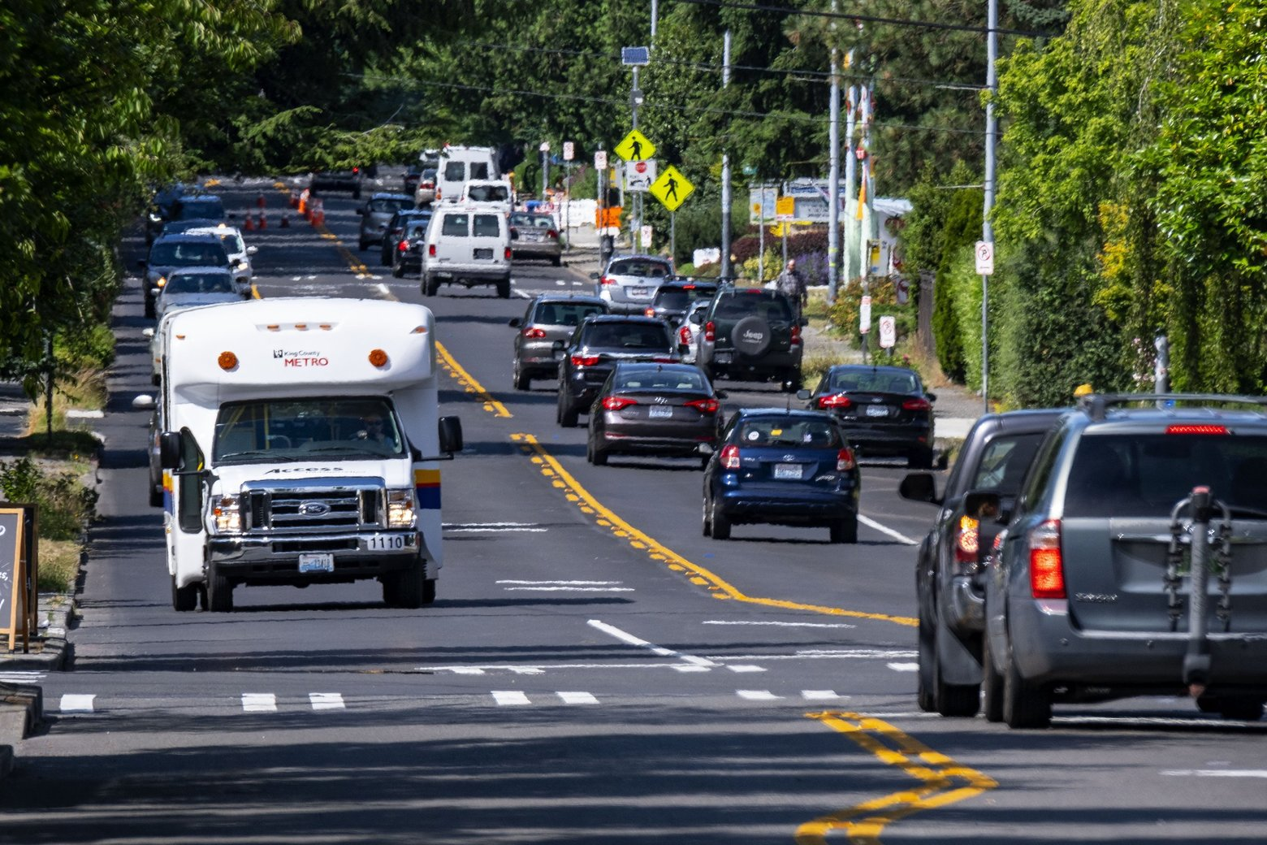
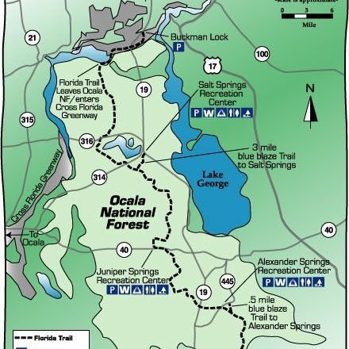
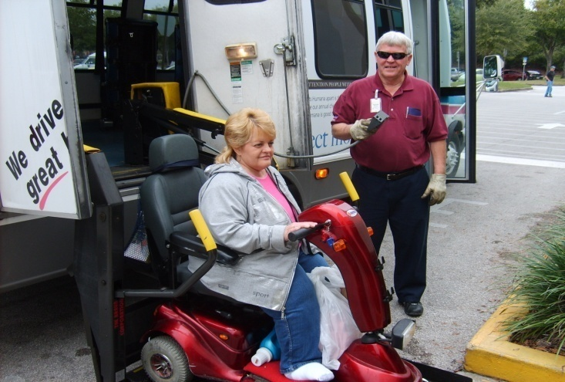

Four Data Sources
The American Community Survey (ACS) – 5-Year Population Data
Federal Highway Administration (FHWA) – Public Roads Mileage Data
CTD Annual Operating Report (AOR) – Systemwide Service Data
CTD Trip & Equipment Program Invoices – TD (Non-Sponsored) Service Data

Slide 22
Analysis of Individual Variables
Each dataset is identical or analogous to a variable within the Formula
Current Formula balances demand (population/square miles) with performance (AOR trips/miles)
This study explores the use of more precise estimates or measures within each of these variables.
Intended to adhere the variables to the guiding principles of the study by using the more precise measures.

Slide 23
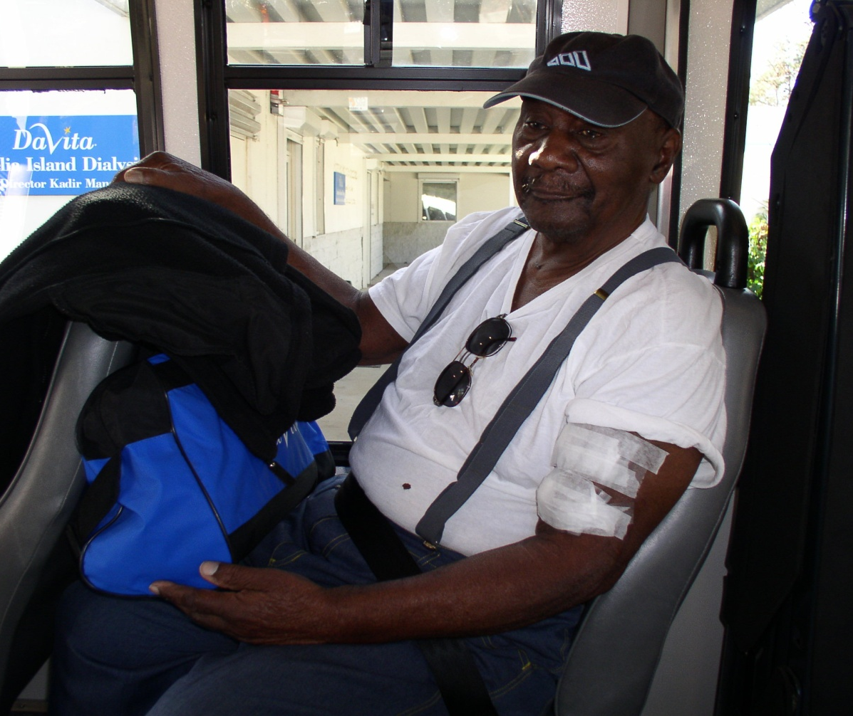

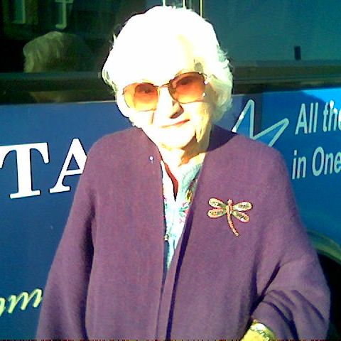

1. Estimating TD Population by County
ACS conducted by the U.S. Census Bureau for 1-year and 5-year estimates on population
Provides detailed data tables on characteristics (e.g., age, income, etc.)
TD population can be estimated by county using the detailed table C18130:
Age – Residents 65 years and older
Disability – Residents living with a disability
Low Income – Residents living below poverty

Slide 24
Applying TD Population Data to the Formula
Access – Allocating funds more directly based on the TD population enhances the value assigned to each TD eligible individual.
Innovation – Using population as a measure of inherent demand allows for innovation by being non-prescriptive.
Accountability – Tailoring allocations more precisely to the TD population fulfills the purpose set forth by the state.
Transparency – Using detailed data from the ACS 5-Year Estimates gives an improved picture of clientele served.

Slide 25

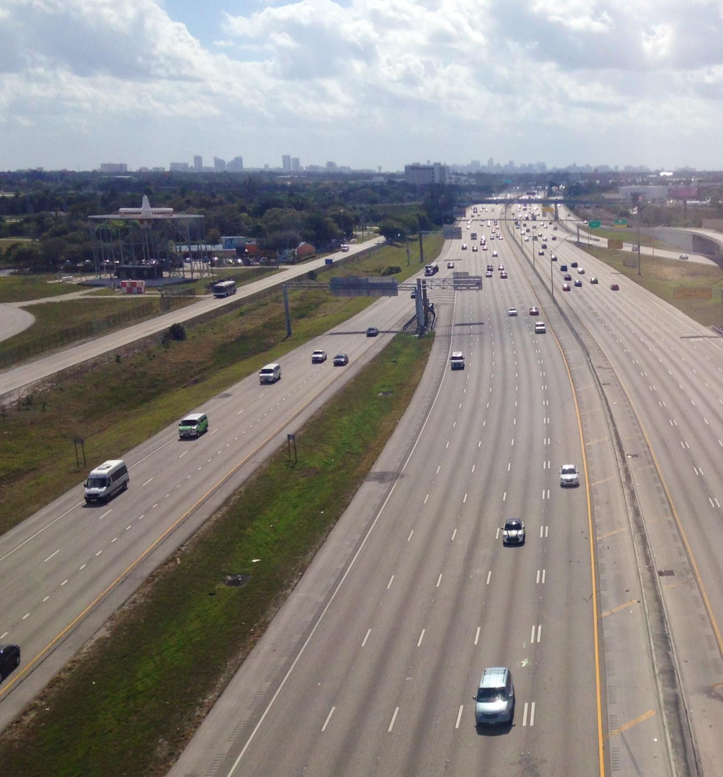
2. Estimating Demand for Transportation by County
FHWA collects mileage and travel data on all roads open for public travel.
Estimating overall demand for transportation (i.e., travel habits) can be done by:
Looking at total population and Centerline Miles (CLM) of public roads; or
Estimating total traffic, or Daily Vehicle Miles Traveled (DVMT), on those roads
FHWA categorizes road data by population areas by:
Rural – Populations of less than 5,000
Small Urban – Populations of 5,000 to 49,000
Small Urbanized – Populations of 50,000 to 200,000
Large Urbanized – Populations of more than 200,000
Data can be broken down by functional classification (e.g., Interstate, county road) and lane miles as well.

Slide 26
Relationship Between CLM and DVMT
There is a strong correlation between total miles of public roads (CLM) and total volume of traffic (DVMT) across Florida’s 67 counties.

Slide 27
Relationship Between Population and DVMT
There is even a stronger correlation between total population and total volume of traffic (DVMT) across Florida’s 67 counties.

Slide 28
Relationship Between Square Miles and DVMT
There is a weaker correlation between a county’s total square miles and total volume of traffic, compared to CLM and total population.

Slide 29
Using CLM Data in the Formula
Transparency – Using public roads data (alternative to square miles) can more accurately estimate the differences in travel habits across diverse counties.
Access – Allocating funds directly for miles of public roads enhances the value for land where the actual provision of TD services (an element of overall transportation) occurs.
If current allocations for square miles were divided by counties’ total CLM, the values per mile would range from $10.58 per mile in Pinellas to $274.09 per mile in Glades.
Innovation – Allocating funds by CLM each year ensures funding is responding to changes in local transportation infrastructure.

Slide 30
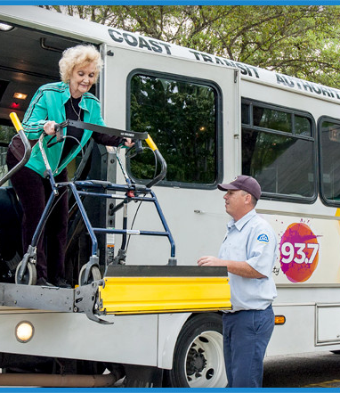
3. Measuring Services Provided Across the Coordinated Transportation System
The AOR provides an overview of all services reported by CTCs, both TD (non-sponsored) and other agencies.
Data include total passenger trips, vehicle miles traveled, unduplicated passengers, trip purposes, revenues, expenses, etc.
Data is compiled in the CTD Annual Performance Report.
Risk of inconsistencies in the way the data is gathered and reported from various sources.

Slide 31

4. Measuring Services Provided under the T&E Grant Program
T&E Grant funds are used to reimburse CTCs for the provision of TD services not sponsored by another agency (i.e., Medicaid).
CTCs submit monthly invoice data to CTD, using standardized formats.
Data on trips and miles are categorized by ambulatory, wheelchair, stretcher, and group types.
Some CTCs submit invoices on bus pass programs for TD riders to access the fixed bus route systems, if available.
Data must be accompanied by support documentation, including date/time of trip, customer name, pick-up/drop-off address, etc.

Slide 32
Using T&E Invoice Data as an Alternative Performance Variable in the Formula
Accountability – Using T&E invoice data (instead of AOR) more directly measures performance of TD non-sponsored services, which the allocations are intended to reimburse.
Access – Allocating funds for services directly reimbursed under the T&E Grant enhances the value assigned to T&E trips.
Coordination – Aligning the allocation Formula with the disbursement of T&E funds (i.e., only funding non-sponsored trips) avoids duplication and supports a more cost-effective provision of services.
Transparency – Using T&E invoice data is more consistent, verifiable, and provides greater detail of services delivered than what is reported by the AOR.

Slide 33

Proposed Changes
Funding Models for Consideration

Slide 34

Summary of Proposed Changes
The study presents four changes (variables) for consideration:
TD Population – Using ACS 5-Year Table C18130, allocate funds more directly to county residents eligible to be served by the TD program.
Centerline Miles – As an alternative to square miles, allocate funds to a county’s total miles of public roads using FHWA data.
T&E Grant Funded Services – Instead of AOR systemwide trips/miles, allocate funds only for TD non-sponsored services (trips, miles, bus passes) using T&E invoice data.
Base Funding – Add the Base as a variable within the Formula and allocate funds based on a percent of a county’s previous year allocation (instead of the amount from FY1999-00).

Slide 35

Proposed Variable Weights
The funding models for consideration assign different weights to datasets within each of the variables, with “1.0” as the standard value.
TD Population – All individuals who fall under at least one of three TD eligible groups (disabled, below poverty, and/or 65 years and older) are weighted equally at 1.0
CLM – Roads data are categized into four population sizes (rural, small urban, small urbanized, and large urbanized), all equally weighted at 1.0.
T&E Services – The different types of trips and bus passes are weighted at an amount relative to the unit cost (or rate) of an ambulatory trip.
A wheelchair trip, for example, is weighted at 1.7 because it is reimbursed 1.7 times the cost of an ambulatory trip.
Miles are weighted at 0.1 the amount for an equivalent type of trip, so that each additional mile in a trip adds 0.1 to the total for the trip.

Slide 36

Calculating Statewide Shares: Alachua County
Once the weighted totals for each variable are tallied, a statewide share for each county by variable can be calculated. Using Alachua County as an example:
Share of TD Population: (96,121/7,589,002) = 1.27%
Share of Centerline Miles: (1,820,154/123,099,224) = 1.48%
Share of T&E Services: (44,483,050/5,290,813.776) = 0.84%
Share of Base: ($650,821/$56,538,360) = 1.15%
Any model that gives greater weight to a variable that represents a higher statewide share for a county will result in more funds being allocated toward that same county.

Slide 37

Models for Consideration
The study presents three models, with varying weighted totals and statewide shares by variable:
Model | Demand (TD + CLM) | Performance | Base | Description
Model 1 | 12.5%+12.5% | 25% | 50% | “Status Quo” approach, uses the similar balance as current formula, just with different datasets
Model 2 | 6.25%+6.25% | 37.5% | 50% | Performance-driven approach, where more weight is given to prior year performance in T&E services
Model 3 | 18.75%+18.75% | 12.5% | 50% | Demand-driven approach, where more weight is given to a county’s TD population and CLM

Slide 38

Calculating Alachua County Share in Each Model
With statewide shares calculated for each county and weights assigned to each variable, it then becomes possible to calculate each county’s share of the total amount appropriated for the T&E Grant (allocation factor) under each model. Taking Alachua County as an example again:
Proposed Variable: Model 1 Model 2 Model 3
Share of TD Population: (1.27%*12.5%) (1.27%*6.25%) (1.27%*18.75%)
Share of CLM: +(1.48%*12.5%) +(1.48%*6.25%) +(1.48%*18.75%)
Share of T&E Services: +(0.84%*25%) +(0.84%*37.5%) +(0.84%*12.5%)
Share of Base: +(1.15%*50%) +(1.15%*50%) +(1.15%*50%)
Allocation Factor =1.13% =1.06% =1.20%

Slide 39
Allocation Amounts for Alachua County Under Each Model
Finally, after calculating the allocation factor under each model, it becomes possible to determine the allocation amount for each county. Using Alachua County as the example:
*Models 1, 2, and 3 assume total funding equal to FY 2020-21 appropriation
Proposed Variable | Model 1 | Model 2 | Model 3 | FY2019-20 (Pre-”Hold Harmless”) | FY2018-19
TD Population | $89,795.08 | $$44,897.54 | $134,692.62
CLM | $104,826.66 | $52,413.33 | $157,239.99
T&E Services | $119,212.29 | $178,818.43 | $59,606.14
Base | $326,435.42 | $326,435.42 | $326,435.42
Total Allocation | $640,269.45 | $602,564.72 | $677,974.18 | $650,820.54 | $605,854.51

Slide 40
Public Input
Stakeholders may submit feedback at: https://ctdallocationstudy.com/
For more information, please contact David Darm, CTD Executive Director, at: David.Darm@dot.state.fl.us

